Slide 1
Orchestrating with Docker Compose
Srinivasan S Iyer

Slide 2
What is Docker Compose?
A tool for defining and running multi- container Docker applications
With Compose, you use a YAML file to configure your application’s services.
Compose works in all environments: production, staging, development, testing, as well as CI workflows.
With a single command, you create and start all the services from your configuration

Slide 3

3 step process of Docker Compose

Slide 4

Docker Compose is a 3 Steps Process
Define your app’s environment with a Dockerfile
Define the services that make up your app in Docker Compose file
Run the CLI:
$ docker-compose up

Slide 5
Building Blocks of Docker Compose

Slide 6


Building Blocks of Docker Compose
A
B
C
Services
Volumes
Networking

Slide 7
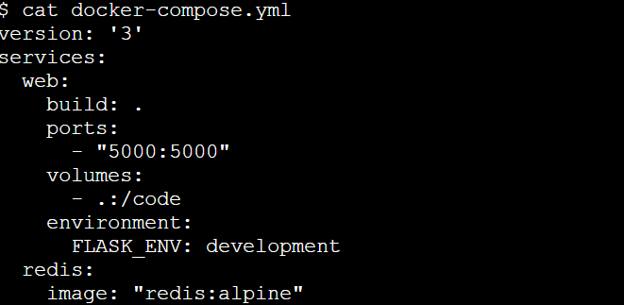
A Sample Docker Compose File

Slide 8
Docker Compose Compatibility Matrix

Slide 9
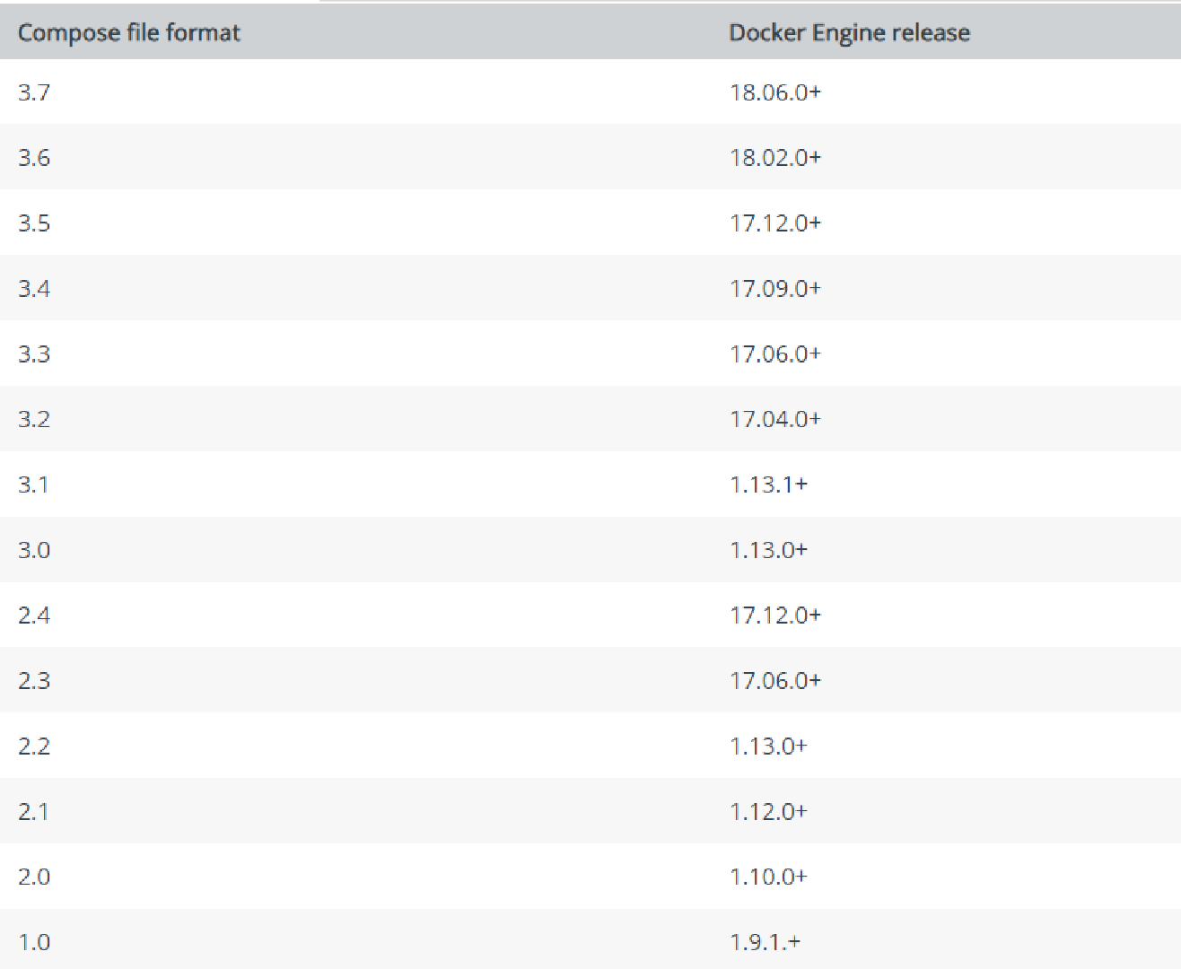
Docker Compose File Format Compatibility Matrix

Slide 10
Environmental Variable in Docker Compose

Slide 11
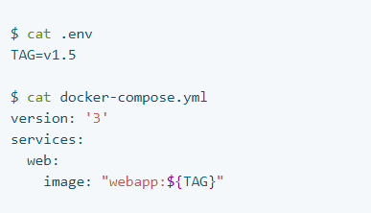
Environmental Variable in Docker Compose:
Using .env file

Slide 12
Environmental Variable in Docker Compose:
Using `docker-compose run` command

Slide 13
Networking in Compose

Slide 14
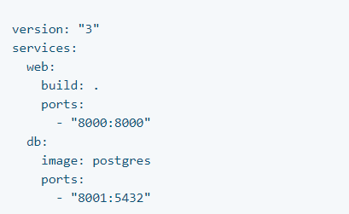
Networking in Compose
A network called myapp_default is created.
A container is created using web’s configuration.
It joins the network myapp_default under the
name web.
A container is created using db’s configuration. It
joins the network myapp_default under the
name db.

Slide 15
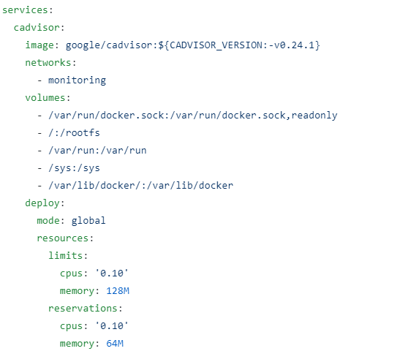
Compose for Swarm Mode
The same Compose file can be used to deploy
containerized apps on multi-host system
The overlay driver creates a named network
across multiple nodes in a swarm.
The “global mode” enable atleast one copy of
apps running on every node of the swarm

Slide 16
How to install Docker Compose?

Slide 17
How to Install Docker Compose
$ curl -L https://github.com/docker/compose/releases/download/1.25.0/docker-compose-
`uname -s`-`uname -m` -o /usr/local/bin/docker-compose
$ chmod +x /usr/local/bin/docker-compose
Note: Docker Desktop will automatically install the latest version of Docker Engine for you.

Slide 18
A Sample WordPress Compose File

